Slide 1
Social-Me (An Event Management Application)
Group Members:
Suraj A. Bobade [2013BCS072]
Sujata S. Regoti [2013BIT039]
Mrunal K. Selokar [2013BCS065]

Slide 2
Contents:
Introduction
Overview
purpose
Overall Description
Version Compatibility
Working
Key Features
references

Slide 3
What is Social-Me?
Social-Me is an android application developed for creation and management of events.
The application focuses on event creation, management and notification system.
The app lets you create event invitations, to be sent by notifications to the group members.

Slide 4
Purpose
The simple and noble aspiration behind the Social-Me application is to simplify the task of event management in simple, easy and efficient way.
The reason behind choosing android as a platform is, it is an open source and most widely (75%-80%) used Mobile OS.

Slide 5
Version Compatibility
Social-Me application is compatible within the wide range of Android versions ranging from 4.2( API level 14) to 6.0.1 (API level 23).

Slide 6
Software Requirements
Development Tool: Android Studio 1.5
Languages: Java, PHP, XML
Database Used: MyPHPadmin-MySQL
Server: Cloud9

Slide 7
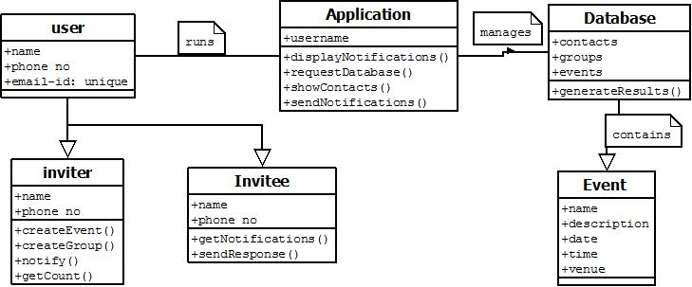
UML Diagrams
1. Class Diagram

Slide 8
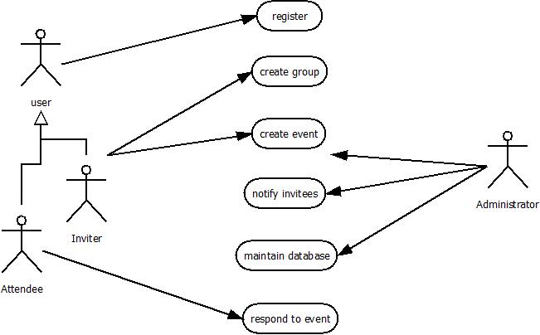
2. USE-CASE Diagram

Slide 9
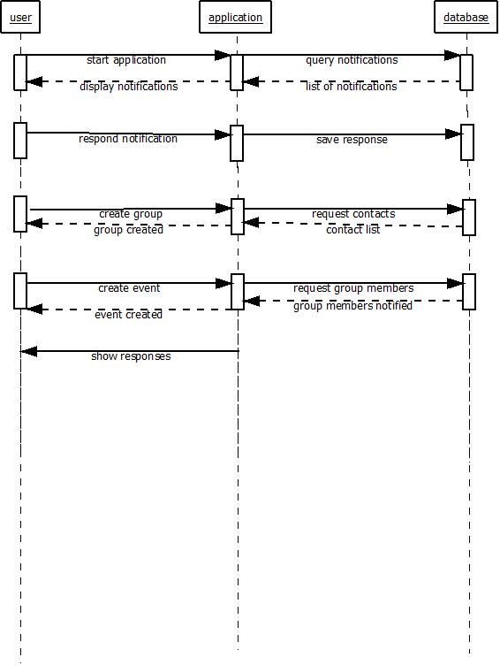
3. Sequence Diagram

Slide 10
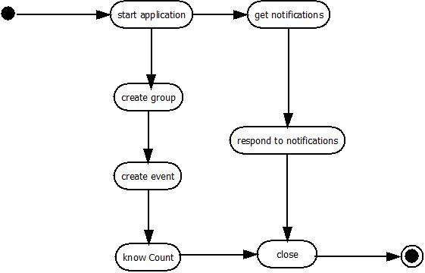
4. Activity Diagram

Slide 11
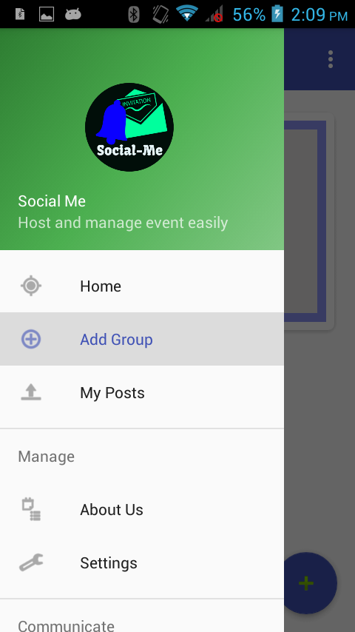
Working:

Slide 12
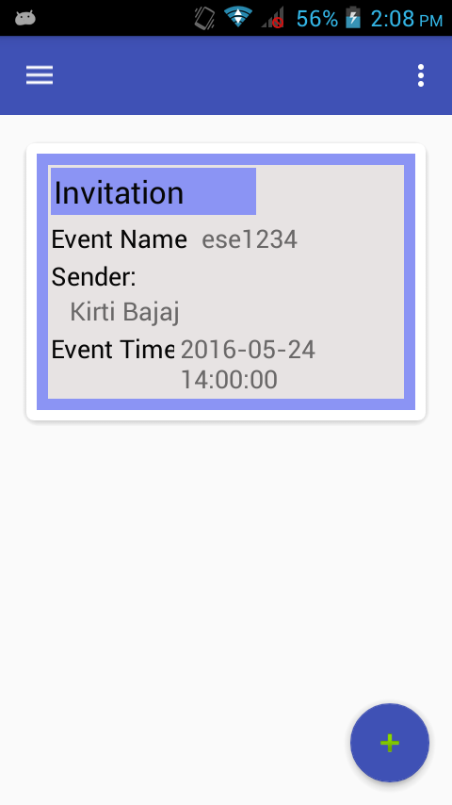
The main activity screen of the application shows the notifications of invitations to join an event.

Slide 13
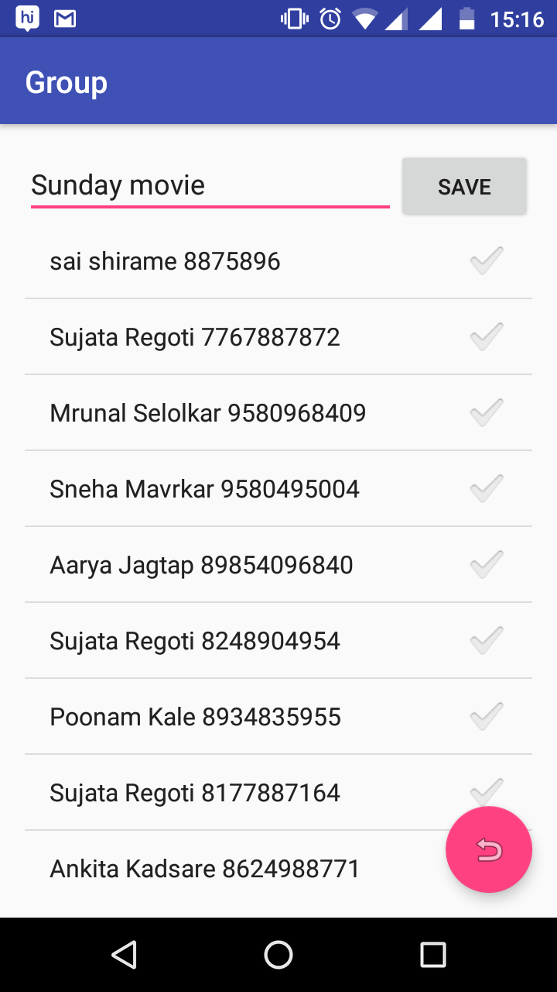
This event is created by the sender in following manner.
The sender has to create a group for the event.
On create group screen, the contact list is displayed.
The sender creates a group by selecting the contacts from the list.

Slide 14
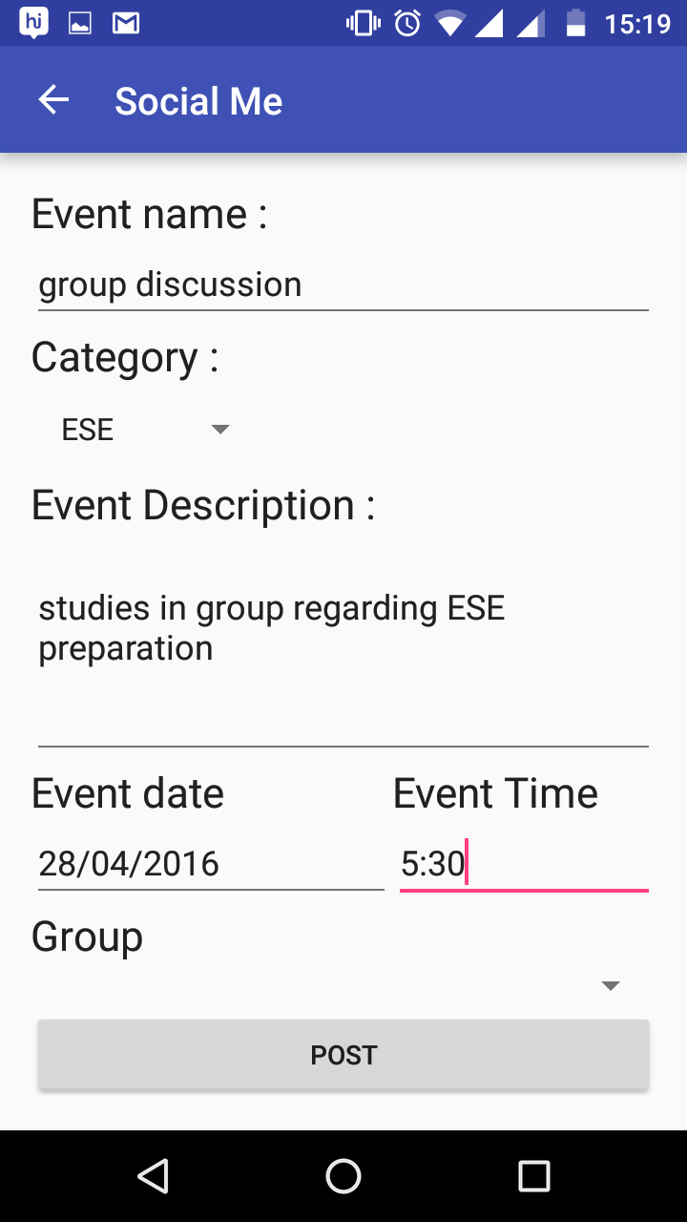
The user then can create an event with the description, date and time of the event.
As the sender creates the event, notification for the event are sent to respective group members.

Slide 15
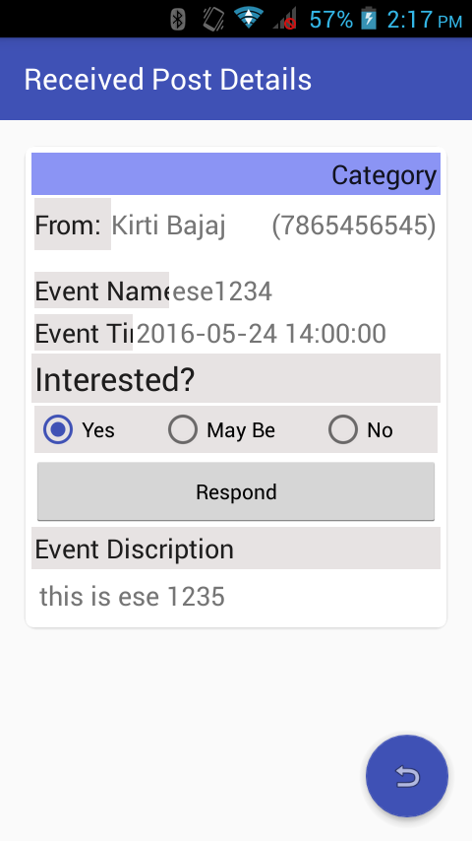
The user can respond to the notifications on event with the 3 response types:
Yes
No
Maybe

Slide 16
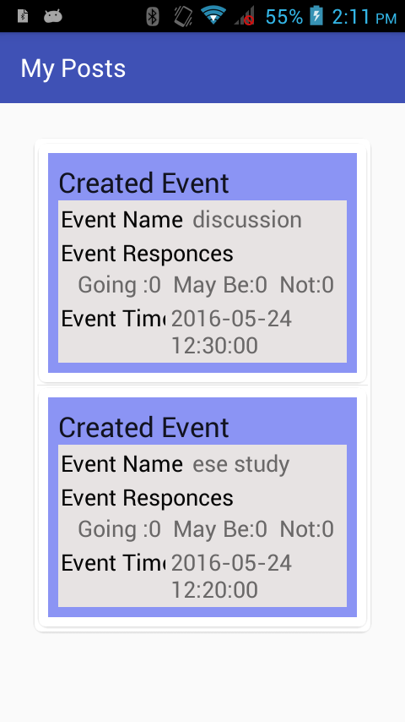
My posts homepage of the sender

Slide 17
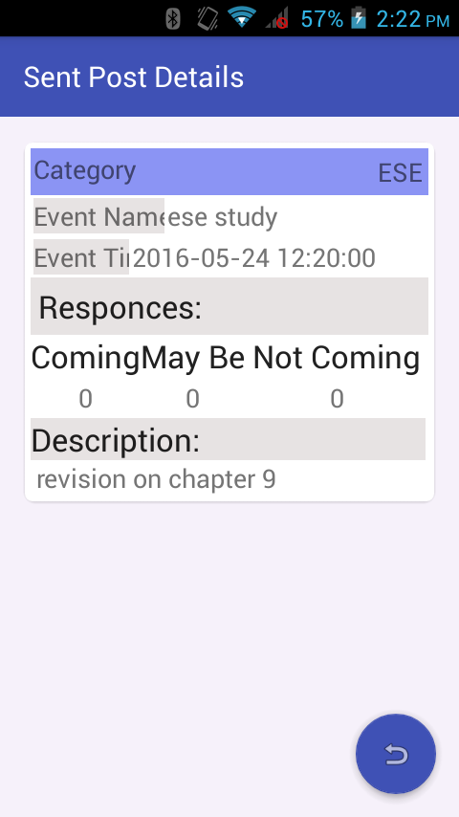
The sender will come to know about the count and names of the people who are interested or un-interested in event.

Slide 18
Key Features
Google standards for android application development are followed.
While designing the User Interface we have followed the Material Design guidelines.

Slide 19
Advantages:
User gets all the work done at a single place, no need to wander for completion of things individually
Effective and time saving
Limitations:
User needs to be online to use the application

Slide 20
Future Scope:
Animations can be improved
User authentication can be provided
Generate event page on Social network(e.g. Facebook )

Slide 21
References:
developers.android.com
stackoverflow.com
androidhive.com
design.google.com

Slide 22
THANK YOU !

